Slide 1
CII Food Safety Award

Slide 2
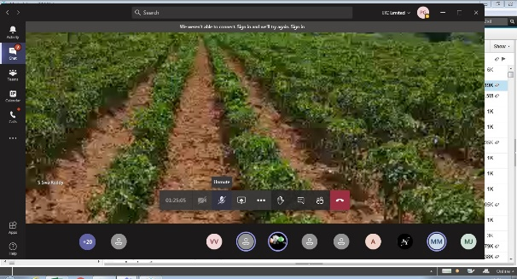
Building a Culture of Excellence, Identifying Role Models & Promoting Global Benchmarks On Food Safety
CII Award for Food Safety
&
CII Food Safety, Quality & Regulatory Summit
Establishing the Global Connect with Participation of FSSAI, WHO, FAO in the Virtual Award Ceremony
Food Safety Award:
More than 600 + Food Business Operators
in about 20 sectors provided
Food Safety Maturity Assessments and Feedback to
Facilitate Global Excellence of Indian FBOs in Food Safety
Virtual FS Award Assessments 2020
Capturing Evidence/ Information/ Examples Virtually
Interviews, Virtual Observations Through
CCTV linked to MS Teams
Remote access
Mobile Cameras and Flashlights
Webcams
Video Shots with date Time tag
Facilitate Access to Best Practices
Notes:
Anju to update

Slide 3
Members of the Jury & Awards Committee
CII Award for Food Safety 2021
Dr. Chindi Vasudevappa Chair, Jury, CII Award for Food Safety, Vice Chancellor, NIFTEM (under Ministry of Food Processing Industry)
Dr Gyanendra Gongal
Regional Advisor (Food safety), Food and Fit, Healthier Populations and NCD, WHO Regional Office for South East Asia
Dr Kaushik Banerjee
Principal Scientist-National Research Centre for Grapes, Chairman India Section AOAC Intl
Dr Nimish Shah
MD, IAPMO India, Chairperson, CII Expert Group on Food Safety & Quality and Formerly Unilever & Toilet Board Coalition
Dr U K Chatterjee – Pre Jury Chair
CEO, TPM Consulting Co
Notes:
Our heartfelt thanks goes out to Jury and Award committee members.

Slide 4
Food Safety Consideration, Criteria and Categories of Recognition

Slide 5
The Most Coveted and Aspired for Award
on Food Safety Excellence – Maturity Assessment
The One of its Kind Award

Slide 6
Food Safety Considerations for the Award
The Award Focuses on Excellence of Prevention & Mitigation of Food Safety Risks related to:
Physical Hazards
Chemical Hazards
Biological Hazards
Allergens
Regulatory requirements
Does Not Include
Nutritional Aspects

Slide 7
Food Safety Maturity Criteria Cutting across Sectors and Supply Chain
Street Food: 1
Manufacturing: 3
Primary Production F/V Fresh Produce - Criteria 5
Hotels & Restaurants, Catering: 2
Wholesale & Warehousing- Criteria 4
Mfg of Pesticides, Cleaning & Sanitation, Packaging : 6
Micro
SMB,
Large
Rising Star
One of its kind Award on Food Safety in the country
7
Joint Application for Excellence in FS through Partnership Development
9
e- Commerce- Grocery
11
Performance Excellence in Food Testing Labs
8
Primary Production Dairy
10
e- Commerce- Packaged Food
12 Innovations in FSMS

Slide 8
Category, Size and Sector Specific Recognitions
Micro (Street Food)
Large
Food Service Sectors
Hotels, Restaurants, Catering
Street Food
Rising Star (less than 3 years in Operation
Manufacturing Sectors
Bakery
Dairy
Ready to Eat
Beverages
Food Warehousing & Wholesale
Ready to Cook
Food Packaging Materials
Regular (3 or more years in operation)
Small & Medium
Food Testing Laboratories
……………………..
Jt Application on Partnership Dev for Food Safety
Dairy
F/V
Primary Produce
………………………
Category
Size/Scale
Sectors
Notes:
Sector specific recognitions were introduced since 2013, based on applications received by the Awards and Jury Panel . This year we received applications from 9 sectors comprising Manufacturing and Food Service .
The Manufacturing sectors were:
Bakery
Beverages
Dairy
Ready to Eat
Ready to Cook
Food Packaging Material
And Under Food Service, we received applications from sectors like
Restaurants
Food Warehousing and Wholesale
Street Food

Slide 9
Basis of Award Assessment Criteria : 2020
Nature of Business | Large (Above 10 Crore) | Small & Medium (10 Crore and below) | Criteria Number | Basis of Criteria
Food Vendors (Mobile Carts and stalls, Meat Shops, Sweet Meat Shops, Confectioneries, Vending and Dispensing.) | Criteria 1 | Criteria 1 | 1 | Based on FSSAI Checkpoints and CII 14 Point Check
Food Service : Hotels & Eateries (Involved in Preparation, Serving, Take Aways with Permanent Establishment and Address) e.g: Restaurants, Catering, Institutional Canteens, Food Courts) | Criteria 2 Large | Criteria 2 for SMB | 2 | Based on ISO 22000: 2018, FSSR and PRP for Food Service establishments Having permanent addresses + Change Management Initiatives + Social Compliance
Manufacturing (Food Processing Companies) | Criteria 3 Large | Criteria 3 for SMB | 3 | Based on ISO 22000: 2018 ISO 22002-1 + FSSR, Change Management Initiatives + Social Compliance
Food Service : Food Wholesale, Retail, Warehousing, Transportation, C&F | Criteria 4 | Criteria 4 | 4 | Based on FSSR + Risk Analysis + Social Compliance+ Change Management Initiatives
Primary Production: Fruits and Vegetables Fresh Produce (On-farm practices, Grading, Packing, Dispatch) | Criteria 5 | Criteria 5 | 5 | Based on Global Gap, Codex Standards + Social and Regulatory Compliance
Packaging & Food Chain Inputs Providers (Manufacturing of Packaging material, Cleaning & Sanitation, Food Equipment, Pest Control) | Criteria 6 | Criteria 6 | 6 | Based on ISO 22000: 2018 & Best Practices in PRP&GMP, Change Management Initiatives + Social & Regulatory Compliance
Joint Application of Customer &Supplier / Co-Packers / Franchise / 3rd Party – Food Safety Excellence through Partnership Development | Criteria 7 | Criteria 7 | Criteria 7 | Best Practices in Partnership Development + Criteria 3 or Criteria 2 as applicable
Primary Production: Dairy Farm | Criteria 8 | Criteria 8 | Criteria 8 | Based on GLOBAL GAP + Social Compliance
E-commerce- Online Marketplace (Grocery, fresh fruits and Vegetables & food products) | Criteria 9 | Criteria 9 | 9 | Based on FSSAI checkpoints for online food delivery + ISO 22000:2018 + FSSR for retail & distribution
E-commerce-Ready to eat cooked Meal | Criteria 10 | Criteria 10 | 10 | Based on FSSAI checkpoints for catering and online food delivery + ISO 22000:2018
Laboratories : Performance of Food Analysis & Testing Labs | Criteria 11 | Criteria 11 | Criteria 11 | Based on ISO 17025:2017, Best Practices & Leadership Initiatives + Statutory & Social Compliance
Innovations with FSMS | Criteria 12 | Criteria 12 | Criteria 12 | Innovation Best Practices with FSMS

Slide 10
Pledged to Confidentiality
Total Applicants
Number of Applicants per sector
Not Shared
But Wide Visibility for all Winners

Slide 11
Recognition levels for Sectors, Size, Category
Sectoral Recognitions
Alcoholic Beverages
Non-Alcoholic Beverages
Bakery
Catering & QSR
Confectionary
Dairy
Egg & Egg Products
Food Testing Laboratories
Health Supplements & Nutraceuticals
Innovations in Food Safety Systems and Practices
Joint Applicant
Meat & Meat Products
Oil & Fats
Sauces & Spices
Warehousing / Transportation & Storage
Snacks & Savories
Cereals & Cereal Products
Food Ingredients & Processing Aids
E-Commerce: Grocery Delivery Service
E-Commerce: Food Delivery Service
----------------------
Street Food
Size & Category wise
Small and Medium
Large
Rising Star
Award Trophy
for Outstanding Performance on Food Safety
Only 1 per Sector per Category per Size
Certificate: Commendation for
Significant Achievement on Food Safety
More than 1
Certificate : Commendation for
Strong Commitment to Excel on Food Safety
More than 1
Certificate : Commendation for
Strong Commitment to Excel in GHP/GMP/GWP/GAP
More than 1
Certificate : Letter of Appreciation on Food Safety Commitment
More than 1

Slide 12
Why this Award

Slide 13
Strengthening a Culture of Excellence in Food Safety through CII Award for Food Safety
Sector Specific
Alcoholic Beverages
Non-Alcoholic Beverages
Bakery
Catering & QSR
Confectionary
Dairy
Egg & Egg Products
Food Ingredients & Processing Aids
Food Testing Laboratories
Health Supplements & Nutraceuticals
Innovations in Food Safety Systems and Practices
Joint Applicant
Meat & Meat Products
Oil & Fats
Sauces & Spices
Warehousing / Transportation & Storage
Snacks & Savories
E-Commerce: Grocery Delivery Service
E-Commerce: Food Delivery Service
Street Food
Capacity Building for the Industry on Global Standards
Self Assessment Tool
External
Recognition
Size & Category
Micro, Small & Medium
Large
Rising Star

Slide 14
The Beneficiaries So Far
Restaurants
Catering,
Hotels
Street Food
Beverages
Poultry
Dairy
Warehouse & Wholesale
Consumers
Indian Food Chain Industries
Exports & Trade
Regulatory Body
Meat
Fresh Fruits & Vegetables
Ready To Eat
Food Certification Bodies
Spices & Flavors
Food Service Providers
Food Retail
Confectionary
Fresh Frozen Produce/ Food Ingredients/

Slide 15
The Growth Statistics Identifying Role Models & Promoting Global Benchmarks On Food Safety
CII Award for Food Safety

Slide 16
Regional Segmentation of Applicant Companies without Micro Sector

Slide 17
Size wise Applicants 2019, 2020 & 2021

Slide 18
Sector wise Applicants 2019, 2020 & 2021

Slide 19
4 Broad Award Models

Slide 20
CII Food Safety Excellence Model
(Applicable for Criteria 2, 3, 4, 6, 7)
Upgraded to ISO 22000: 2018
150
A Model complying to the expectations from a Global Supplier
Change Management
Initiatives
700
PRP , HACCP, Food Safety Management
Customised to SMEs, Medium & Large,
Manufacturing & Food Service
150
Product specific GMP / GHP/ GWP / GAP
Eligibility Criteria
Social, Statutory &
Regulatory Compliance
1000 : Total Marks
Notes:
4.5 THE EFQM EXCELLENCE MODEL
© EFQM 1999

Slide 21
Marks Distribution: Manufacturing Criteria 3
Section A : Self-Declaration
A 1 | Statutory and Regulatory Requirements
A 2 | Social Compliance
Section B : | Food Safety Practices | Highest Possible Score
B 1 | Pre Requisite Programs (based on ISO 22002-1) | 350
B 2 | Hazard Control Plan based on ISO 22000:2018 | 175
B 3 | Food Safety Management System Structure based on ISO 22000: 2018 | 175
Section C : | Sector Specific Good Manufacturing Practices (GMP) | Highest Possible Score
C | Sector Specific GMP based on relevant Codes & Best Practices | 150
Section D : | Change Management Initiatives | Highest Possible Score
D 1 | Enablers for Change Management Initiatives | 30
D 2 | Outcome of System Standards, Tools, Techniques and Operating Philosophies | 25
D 3 | Recognition and reward of people | 20
D 4 | Involvement of the Unit in championing and disseminating the message of Food Safety, Quality, Sustainability, Business Excellence & others | 15
D 5 | COVID 19 Norms and Best Practices | 60
* Additional assessment focus & detailed information to be provided in the findings column of the yellow highlighted section

Slide 22
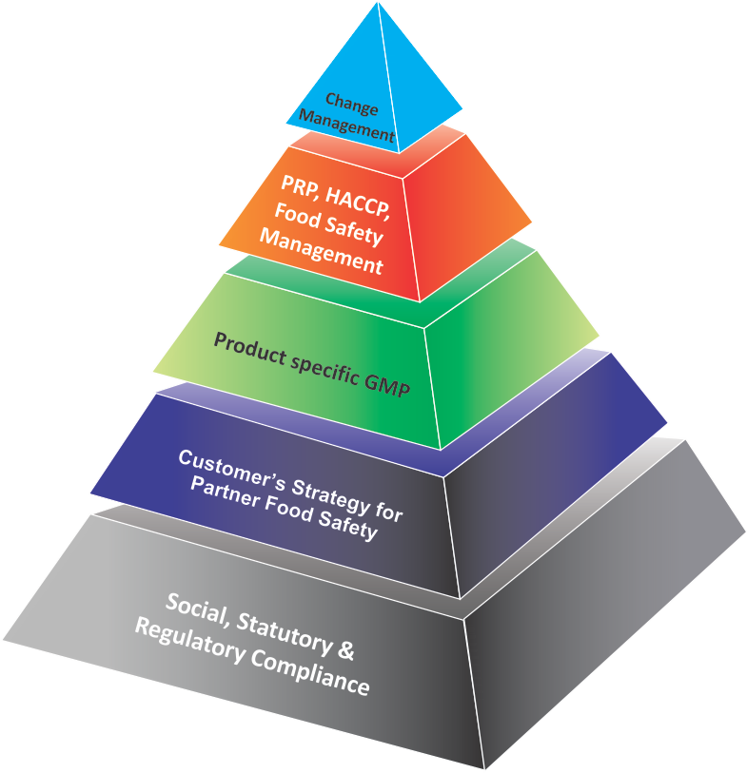
New Introduction 2019
Criteria 7: Joint Application of Customer and Partner
on Partnership Development for Food Safety Excellence
Joint Application of Customer &Supplier /
Co-Packers / Franchise / 3rd Party –
Food Safety Excellence through
Partnership Development
150
700
150
500
4 days Assessment with 3 assessors (estimated)
Total 1500

Slide 23
Score Distribution : Partnership Development
Criteria 7B
Sl.No |  | Max Score
1 | Management of Partnerships towards improved food safety performance levels and sustainable development | 200
a | What are the criteria of selection of the Partners | 10
b | What components comprise Ongoing Evaluation of Partners | 10
c | How are Partner Ratings done and feedback communicated? | 20
d | How comprehensively are Strengths/Weaknesses/ Opportunities/ Threats and other relevant areas of the Partner built into the Strategy Planning Process of the Customer | 20
e | How effective is the communication mechanism of the Customer with the Partner on policy, objectives, goals, roadmaps and priorities | 20
f | How effective is the review mechanism between Customer and Partner | 20
g | How are Partner capabilities developed for improving performance levels (e.g Training, Competence building, effectiveness assessment, refresher programs etc) | 20
h | How are Partner Satisfaction surveys carried out and wat is the quality of actions taken by customer for improvement | 20
i | Provide examples of joint performance improvement initiatives taken to generate and support innovative / creative thinking through the partnership | 30
k | How are Partners encouraged to perform better (reward and recognitions and others) | 30
CII Award for Food Safety Joint Application of Customer & Supplier / Co-Packers / Franchise / 3rd Party -Food Safety Excellence through Partnership Development (V1)
 | Management of Suppliers / Co-packers/ 3rd Party/ Outsourcing parties/ others as Partners | 500
1 | Management of Partnerships towards improved food safety performance levels and sustainable development | 200
2 | Assistance towards Partners' Resources: | 200
3 | Quality of Tracking and Reviewing with data | 100

Slide 24
Marks Distribution : Criteria 7B
2 | Assistance towards Partner’s Resources | 200
a | Assistance on Design of Buildings, Facilities, and Layout design are provided and are oriented towards Food Safety | 60
b | Assistance on Raw and Finished Material and Operations(e.g preparation of specification sheets including food safety parameters, availability of right quality material , inventory, storage, warehousing, transportation management, cleaning, pest management and others) | 60
c | Assistance on Technology Management in Equipments and Utilities towards delivering food safety and quality (e.g replacing old technology, use of appropriate manufacturing-monitoring-detection-predictive technology, mistake proofing, maximising existing technology and others) | 60
d | Information and Knowledge Management for Partners to facilitate fact and data based decision making (e.g collecting and structuring information and knowledge, sharing relevant and timely information and knowledge, ensuring integrity and security of information, help with improvements and others) | 20
3 | Quality of Tracking and Reviewing with data | 100
 | How comprehensively are benefits accrued from Partnership development tracked by the company and presented in this document (result trends and improvements) | 100
7A
(Criteria 2, 3,4, 5,6 or as required)

Slide 25
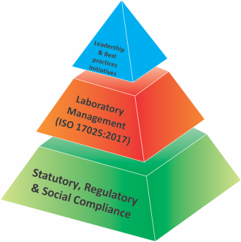
New CII Award for Excellence in Food Testing Laboratory Model
Criteria 11
Launched the Assessor Training for CII Lab Award in 2019
600 Marks
400 Marks
Eligibility Criteria
1000 : Total Marks

Slide 26
Food Testing Laboratories
Marks Distribution : Criteria 11
 | Section B : Laboratory Management (ISO 17025:2017 Compliance) | Highest Score
1 | Scope | 36
2 | Role Clarity | 18
3 | Personnel | 36
4 | Facilities and environmental conditions | 27
5 | Equipment | 36
6 | Metrological Traceability | 18
7 | Nonconforming work | 18
8 | Sampling, Handling of Test or Calibration Items | 45
9 | Measurement Uncertainty | 18
10 | Customer Complaints Handling | 18
11 | Technical records, Reporting of results & Control of Data & Information management | 30
12 | Review of requests, Tenders and Contracts | 10
13 | Selection, Verification and Validation of Methods | 36
14 | Improvement & Corrective Actions | 27
15 | Internal Audits | 18
16 | Management System Documentation & Control of Records | 9
 | Total | 400
Section A
Statutory, Regulatory & Social Compliance | Eligibility
 | Section C : Leadership and Best Practices in Laboratory Initiatives | Highest Score
1 | Integrity of Management | 45
2 | Actions to address risks and opportunities | 45
3 | Management Reviews | 45
4 | Additional Scope of Services | 45
5 | Excellence of Equipment & Technology | 45
6 | Validity of Results | 45
7 | Upgradation Process of the Laboratory | 45
8 | Learning and Development | 45
9 | External Approvals | 45
10 | Customer Feedback & Excellence of Service Results | 45
11 | Reward and Recognition System for Employees | 45
12 | Awards and Accolades for the Laboratory | 45
13 | Sustainability Activities & COVID 19 Norms and Best Practices | 60
 | Total | 600

Slide 27
Innovation Management for Food Safety (Approaches, Technologies & Processes, Methodologies and Others)
New 2020
Section A : Self Declaration
A 1 | Statutory and Regulatory Requirements
A 2 | Social Compliance
Section B : | Food Safety Practices | Highest Possible Score 200
B 1 | Pre Requisite Programs (Based on ISO 22002-1) | 200
Section C : | Innovation Management (Enablers and Results) (Need to apply with 4 best Innovations) | Highest Possible Score 800
C1 | Innovation No: 1 | 200
C2 | Innovation No: 2 | 200
C3 | Innovation No: 3 | 200
C4 | Innovation No: 4 | 200
 | Total Score | 1000

Slide 28
What is Maturity Assessment

Slide 29
What is Maturity Assessment of Food Safety
Assessment of
Enablers
Results
Approaches,
Deployment,
Review Systems
Improvements
Trends of Results
Targets of Results
Comparison with Benchmarks
Improvements

Slide 30
The Award Feedback Report
A 100+page document comprising
Key Strengths and Opportunities for Improvement on each Checkpoint
Covers Enablers and Results as captured during the On site Assessment
Scoring as per Maturity Matrix
The Award Feedback Report Aims to :
Stimulate solutions on food safety
Help the FBO Develop a roadmap for its journey to Food Safety Excellence

Slide 31
The Award Assessment Process

Slide 32
The Rigor of Assessment (More than 100 man hrs per Unit)
4. Assessor Training conducted for new Assessor pool
2. CII-FACE receives LOI
3. Eligibility checked Application Document sent
5. Refresher Training for existing assessors
1. Award Applications Invited
6. Assessor Teams composed
8. Feedback Reports and scores reviewed for consistency
11.Awards Gala Night
at CII Food Safety & Quality Summit
10. Jury Meeting finalises Winners
7. Site Visits conducted ~100 hrs / Assessment
9. Awards Committee Meeting to verify award conduct
12. Despatch Feedback Reports to Applicants
Notes:
Mandays: 10x3x3 (On site)+6 (Site Visit Planning & Preparation) + 8 (Calibration & Feedback report by Sr Assessor)=104 hrs

Slide 33
Criteria for Selecting Assessors
for the Award Assessment
Participation in 2 day Assessor Training Course
Performance in Individual and Syndicate Exercises
Participation in Refresher Course (for existing practicing and qualified FS Award Assessor)
Extent of Exposure to ISO 22000 & GFSI Standards
Qualified FSMS and Quality Auditor
Implementation experience of FSMS & QMS in Food Chain
Sector Specific Expertise
No. of Years of experience in Food Industry
Non Competitor Organisation

